Slide 1
License
Except as otherwise noted, the content of this presentation is licensed under the Creative Commons Attribution 2.5 License.

Slide 2
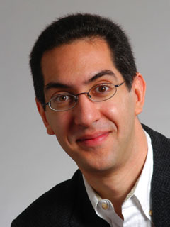
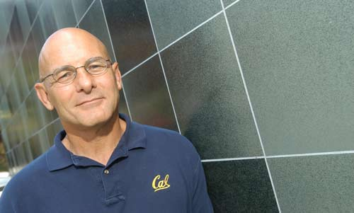
Uc berkeley EECS par labs opens!
inst.eecs.berkeley.edu/~cs61c
UCB CS61C : Machine Structures
Lecture 40 –
Parallelism in Processor Design
2008-05-05
Lecturer SOE Dan Garcia
How parallel is your processor?
UC Berkeley has partnered with Intel and Microsoft to build the world’s #1 research lab to “accelerate developments in parallel computing and advance the powerful benefits of multi-core processing to mainstream consumer and business computers.”
parlab.eecs.berkeley.edu

Slide 3
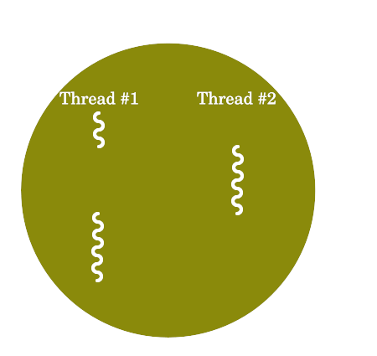
Background: Threads
A Thread stands for “thread of execution”, is a single stream of instructions
  A program can split, or fork itself into separate threads, which can (in theory) execute simultaneously.
  It has its own registers, PC, etc.
  Threads from the same process operate in the same virtual address space
    switching threads faster than switching processes!
  An easy way to describe/think about parallelism
A single CPU can execute many threads by
Time Division Multipexing
Thread₀
CPU
Thread₁
Time
Thread₂

Slide 4
Background: Multithreading
Multithreading is running multiple threads through the same hardware
Could we do Time Division Multipexing better in hardware?
Sure, if we had the HW to support it!

Slide 5
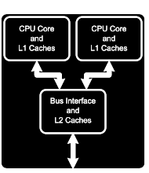
Background: Multicore
Put multiple CPU’s on the same die
Why is this better than multiple dies?
  Smaller, Cheaper
  Closer, so lower inter-processor latency
  Can share a L2 Cache (complicated)
  Less power
Cost of multicore:
  Complexity
  Slower single-thread execution

Slide 6
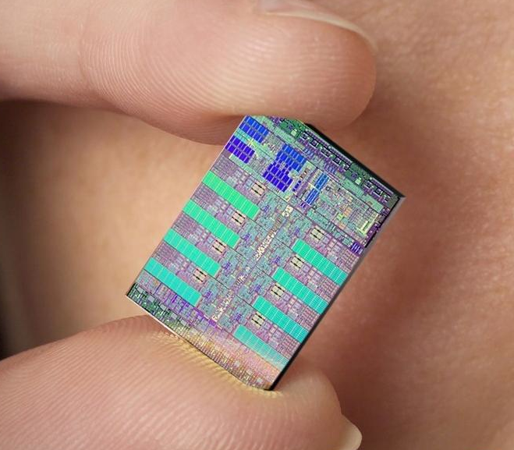
Cell Processor (heart of the PS3)
9 Cores (1PPE, 8SPE) at 3.2GHz
Power Processing Element (PPE)
  Supervises all activities, allocates work
  Is multithreaded (2 threads)
Synergystic Processing Element (SPE)
  Where work gets done
  Very Superscalar
  No Cache, only “Local Store”
    aka “Scratchpad RAM”
  During testing, one “locked out”
    I.e., it didn’t work; shut down

Slide 7
Peer Instruction
The majority of PS3’s processing power comes from the Cell processor
Berkeley profs believe multicore is the future of computing
Current multicore techniques can scale well to many (32+) cores
ABC
0: FFF
1: FFT
2: FTF
3: FTT
4: TFF
5: TFT
6: TTF
7: TTT

Slide 8
Peer Instruction Answer
All PS3 is 2.18TFLOPS, Cell is only 204GFLOPS
(GPU can do a lot…) FALSE
Not multicore, manycore! FALSE
Share memory and caches huge barrier.
That’s why Cell has Local Store! FALSE
The majority of PS3’s processing power comes from the Cell processor
Berkeley profs believe multicore is the future of computing
Current multicore techniques can scale well to many (32+) cores
ABC
0: FFF
1: FFT
2: FTF
3: FTT
4: TFF
5: TFT
6: TTF
7: TTT

Slide 9
Conventional Wisdom (CW) in Computer Architecture
Old CW: Power is free, but transistors expensive
New CW: Power wall Power expensive, transistors “free”
  Can put more transistors on a chip than have power to turn on
Old CW: Multiplies slow, but loads fast
New CW: Memory wall Loads slow, multiplies fast
  200 clocks to DRAM, but even FP multiplies only 4 clocks
Old CW: More ILP via compiler / architecture innovation
  Branch prediction, speculation, Out-of-order execution, VLIW, …
New CW: ILP wall Diminishing returns on more ILP
Old CW: 2X CPU Performance every 18 months
New CW: Power Wall+Memory Wall+ILP Wall = Brick Wall

Slide 10
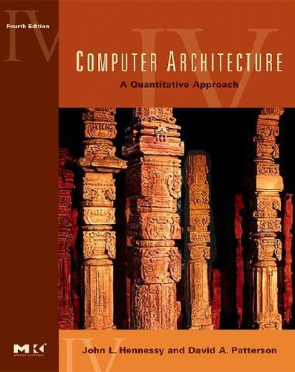
Uniprocessor Performance (SPECint)
3X
From Hennessy and Patterson, Computer Architecture: A Quantitative Approach, 4th edition, Sept. 15, 2006
⇒ Sea change in chip design: multiple “cores” or processors per chip
VAX : 25%/year 1978 to 1986
RISC + x86: 52%/year 1986 to 2002
RISC + x86: ??%/year 2002 to present

Slide 11
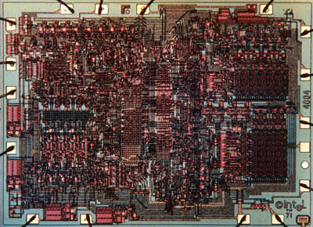
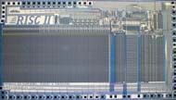
Sea Change in Chip Design
Intel 4004 (1971)
  4-bit processor,
  2312 transistors, 0.4 MHz,
  10 micron PMOS, 11 mm² chip
RISC II (1983)
  32-bit, 5 stage
  pipeline, 40,760 transistors, 3 MHz,
  3 micron NMOS, 60 mm² chip
125 mm² chip, 0.065 micron CMOS
= 2312 RISC II + FPU + Icache + Dcache
  RISC II shrinks to ≈ 0.02 mm² at 65 nm
  Caches via DRAM or 1 transistor SRAM or 3D chip stacking
  Proximity Communication via capacitive coupling at > 1 TB/s ?
  (Ivan Sutherland @ Sun / Berkeley)
Processor is the new transistor!

Slide 12
Parallelism again? What’s different this time?
“This shift toward increasing parallelism is not a triumphant stride forward based on breakthroughs in novel software and architectures for parallelism; instead, this plunge into parallelism is actually a retreat from even greater challenges that thwart efficient silicon implementation of traditional uniprocessor architectures.”
– Berkeley View, December 2006
HW/SW Industry bet its future that breakthroughs will appear before it’s too late
view.eecs.berkeley.edu

Slide 13
Need a New Approach
Berkeley researchers from many backgrounds met between February 2005 and December 2006 to discuss parallelism
  Circuit design, computer architecture, massively parallel computing, computer-aided design, embedded hardware and software, programming languages, compilers, scientific programming, and numerical analysis
Krste Asanovic, Ras Bodik, Jim Demmel, Edward Lee, John Kubiatowicz, George Necula, Kurt Keutzer, Dave Patterson, Koshik Sen, John Shalf, Kathy Yelick + others
Tried to learn from successes in embedded and high performance computing (HPC)
Led to 7 Questions to frame parallel research

Slide 14
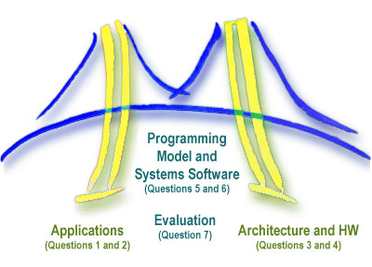
7 Questions for Parallelism
Applications:
1. What are the apps?
2. What are kernels of apps?
Architecture & Hardware:
3. What are HW building blocks?
4. How to connect them?
Programming Model & Systems Software:
5. How to describe apps & kernels?
6. How to program the HW?
Evaluation:
7. How to measure success?
(Inspired by a view of the
Golden Gate Bridge from Berkeley)

Slide 15

Hardware Tower: What are problems?
Power limits leading edge chip designs
  Intel Tejas Pentium 4 cancelled due to power issues
Yield on leading edge processes dropping dramatically
  IBM quotes yields of 10 – 20% on 8-processor Cell
Design/validation leading edge chip is becoming unmanageable
  Verification teams > design teams on leading edge processors
Notes:
Autotuners is fine. I had a slightly longer list I was working on before seeing Krste's mail. PHiPAC: Dense linear algebra (Krste, Jim, Jeff Bilmes and others at UCB) PHiPAC = Portable High Performance Ansi C FFTW: Fastest Fourier Transforms in the West (from Matteo Frigo and Steve Johnson at MIT; Matteo is now at IBM) Atlas: Dense linear algebra now the "standard" for many BLAS implementations; used in Matlab, for example. (Jack Dongarra, Clint Whaley et al) Sparsity: Sparse linear algebra (Eun-Jin Im and Kathy at UCB) Spiral: DSP algorithms including FFTs and other transforms (Markus Pueschel, José M. F. Moura et al) OSKI: Sparse linear algebra (Rich Vuduc, Jim and Kathy, From the Bebop project at UCB) In addition there are groups at Rice, USC, UIUC, Cornell, UT Austin, UCB (Titanium), LLNL and others working on compilers that include an auto-tuning (Search-based) optimization phase. Both the Bebop group and the Atlas group have done work on automatic tuning of collective communication routines for supercomputers/clusters, but this is ongoing. I'll send a slide with an autotuning example later. Kathy

Slide 16
HW Solution: Small is Beautiful
Expect modestly pipelined (5- to 9-stage)
CPUs, FPUs, vector, Single Inst Multiple Data (SIMD) Processing Elements (PEs)
  Small cores not much slower than large cores
Parallel is energy efficient path to performance:
  POWER ≈ VOLTAGE²
  Lower threshold and supply voltages lowers energy per op
Redundant processors can improve chip yield
  Cisco Metro 188 CPUs + 4 spares; Cell in PS3
Small, regular processing elements easier to verify
Notes:
Autotuners is fine. I had a slightly longer list I was working on before seeing Krste's mail. PHiPAC: Dense linear algebra (Krste, Jim, Jeff Bilmes and others at UCB) PHiPAC = Portable High Performance Ansi C FFTW: Fastest Fourier Transforms in the West (from Matteo Frigo and Steve Johnson at MIT; Matteo is now at IBM) Atlas: Dense linear algebra now the "standard" for many BLAS implementations; used in Matlab, for example. (Jack Dongarra, Clint Whaley et al) Sparsity: Sparse linear algebra (Eun-Jin Im and Kathy at UCB) Spiral: DSP algorithms including FFTs and other transforms (Markus Pueschel, José M. F. Moura et al) OSKI: Sparse linear algebra (Rich Vuduc, Jim and Kathy, From the Bebop project at UCB) In addition there are groups at Rice, USC, UIUC, Cornell, UT Austin, UCB (Titanium), LLNL and others working on compilers that include an auto-tuning (Search-based) optimization phase. Both the Bebop group and the Atlas group have done work on automatic tuning of collective communication routines for supercomputers/clusters, but this is ongoing. I'll send a slide with an autotuning example later. Kathy

Slide 17
Number of Cores/Socket
We need revolution, not evolution
Software or architecture alone can’t fix parallel programming problem, need innovations in both
“Multicore” 2X cores per generation: 2, 4, 8, …
“Manycore” 100s is highest performance per unit area, and per Watt, then 2X per generation:
64, 128, 256, 512, 1024 …
Multicore architectures & Programming Models good for 2 to 32 cores won’t evolve to Manycore systems of 1000’s of processors
⇒ Desperately need HW/SW models that work for Manycore or will run out of steam
(as ILP ran out of steam at 4 instructions)

Slide 18
Measuring Success: What are the problems?
≈ Only companies can build HW; it takes years
Software people don’t start working hard until hardware arrives
  3 months after HW arrives, SW people list everything that must be fixed, then we all wait 4 years for next iteration of HW/SW
How get 1000 CPU systems in hands of researchers to innovate in timely fashion on in algorithms, compilers, languages, OS, architectures, … ?
Can avoid waiting years between HW/SW iterations?

Slide 19

Build Academic Manycore from FPGAs
As ≈ 16 CPUs will fit in Field Programmable Gate Array (FPGA), 1000-CPU system from ≈ 64 FPGAs?
  8 32-bit simple “soft core” RISC at 100MHz in 2004 (Virtex-II)
  FPGA generations every 1.5 yrs; ≈ 2X CPUs, ≈ 1.2X clock rate
HW research community does logic design (“gate shareware”) to create out-of-the-box, Manycore
  E.g., 1000 processor, standard ISA binary-compatible, 64-bit,
  cache-coherent supercomputer @ ≈ 150 MHz/CPU in 2007
  RAMPants: 10 faculty at Berkeley, CMU, MIT, Stanford, Texas, and Washington
“Research Accelerator for Multiple Processors” as a vehicle to attract many to parallel challenge

Slide 20
And in Conclusion…
Everything is changing
Old conventional wisdom is out
We desperately need new approach to HW and SW based on parallelism since industry has bet its future that parallelism works
Need to create a “watering hole” to bring everyone together to quickly find that solution
  architects, language designers, application experts, numerical analysts, algorithm designers, programmers, …

Slide 21
Bonus slides
These are extra slides that used to be included in lecture notes, but have been moved to this, the “bonus” area to serve as a supplement.
The slides will appear in the order they would have in the normal presentation
Bonus

Slide 22
Why is Manycore Good for Research?
 | SMP | Cluster | Simulate | RAMP
Scalability (1k CPUs) | C | A | A | A
Cost (1k CPUs) | F ($40M) | C ($2-3M) | A+ ($0M) | A ($0.1-0.2M)
Cost of ownership | A | D | A | A
Power/Space (kilowatts, racks) | D (120 kw, 12 racks) | D (120 kw, 12 racks) | A+ (.1 kw, 0.1 racks) | A (1.5 kw, 0.3 racks)
Community | D | A | A | A
Observability | D | C | A+ | A+
Reproducibility | B | D | A+ | A+
Reconfigurability | D | C | A+ | A+
Credibility | A+ | A+ | F | B+/A-
Perform. (clock) | A (2 GHz) | A (3 GHz) | F (0 GHz) | C (0.1 GHz)
GPA | C | B- | B | A-

Slide 23


Multiprocessing Watering Hole
RAMP
Parallel file system
Dataflow language/computer
Data center in a box
Fault insertion to check dependability
Router design
Compile to FPGA
Flight Data Recorder
Security enhancements
Transactional Memory
Internet in a box
128-bit Floating Point Libraries
Parallel languages
Killer app: ≈ All CS Research, Advanced Development
RAMP attracts many communities to shared artifact
⇒ Cross-disciplinary interactions
RAMP as next Standard Research/AD Platform?
(e.g., VAX/BSD Unix in 1980s)

Slide 24
Reasons for Optimism towards Parallel Revolution this time
End of sequential microprocessor/faster clock rates
  No looming sequential juggernaut to kill parallel revolution
SW & HW industries fully committed to parallelism
  End of La-Z-Boy Programming Era
Moore’s Law continues, so soon can put 1000s of simple cores on an economical chip
Communication between cores within a chip at
low latency (20X) and high bandwidth (100X)
  Processor-to-Processor fast even if Memory slow
All cores equal distance to shared main memory
  Less data distribution challenges
Open Source Software movement means that SW stack can evolve more quickly than in past
RAMP as vehicle to ramp up parallel research

