Slide 1
An Introduction to OMNeT++ 4.5 based on Documention from http://www.omnetpp.org/
Christian Timmerer
October 2014
Alpen-Adria-Universität Klagenfurt (AAU)  Faculty of Technical Sciences (TEWI)
Institute of Information Technology (ITEC)  Multimedia Communication (MMC)
http://blog.timmerer.com  @timse7  mailto:christian.timmerer@itec.uni-klu.ac.at
Change Log:
Oct’14: Update to 4.5
Oct’13: Update to 4.3
Oct’12: Update to 4.2
Oct’11: Minor corrections and updates
Oct’10: Update to 4.1
Oct’09: Update to 4.0 incl. IDE
Oct’08: Initial version based on OMNet++ 3.3

Slide 2
Outline
Introduction
OMNet++ in a Nutshell
What does OMNeT++ provide then?
OK. What does an OMNeT++ simulation model look like?
How do I run this thing?
OK! Now, how do I program a model in C++?
Working with OMNet++: Flow Chart
TicToc Tutorial
Getting started
Enhancing the 2-node TicToc
Turning into a real network
Adding statistics collection
Visualizing the results with the OMNeT++ IDE
Conclusions

Slide 3
Introduction
Discrete event simulator
Hierarchically nested modules
Modules communicate using messages through channels
Basic machinery and tools to write simulations
Does not provide any components specifically for computer network simulations, queuing network simulations, system architecture simulations or any other area
Written in C++
Source code publicly available
Simulation model for Internet, IPv6, Mobility, etc. available
Free for academic use
Commercial version: OMNESTTM
Pros
Well structured, highly modular, not limited to network protocol simulations (e.g., like ns2)
Cons
Relatively young and only few simulation models – not young anymore, mature, comes with IDE, good documentation, and simulation models are available

Slide 4
OMNet++ in a Nutshell: What does OMNeT++ provide then?
C++ class library
Simulation kernel
Utility classes (for random number generation, statistics collection, topology discovery etc.)
⇨ use to create simulation components (simple modules and channels)
Infrastructure to assemble simulations
Network Description Language (NED)
.ini files
Runtime user interfaces
Tkenv
Cmdenv
Eclipse-based simulation IDE for designing, running and evaluating simulations
Extension interfaces for real-time simulation, emulation, MRIP, parallel distributed simulation, database connectivity and so on
Notes:
MRIP = multiple replications in parallel

Slide 5
OMNet++ in a Nutshell: OK. What does an OMNeT++ simulation model look like?
// Host with an Ethernet interface
module EtherStation {
parameters: ...
gates: ...
input in; // for conn. to switch/hub, etc
output out;
submodules:
app: EtherTrafficGen;
llc: EtherLLC;
mac: EtherMAC;
connections:
app.out --> llc.hlIn;
app.in <-- llc.hlOut;
llc.macIn <-- mac.llcOut;
llc.macOout --> mac.llcIn;
mac.phyIn <-- in;
mac.phyOut --> out;
}
OMNet++ provides component-based architecture
Models assembled from reusable components = modules (can be combined in various way like LEGO blocks)
Modules can be connected with each other through gates, and combined to form compound modules
// Ethernet CSMA/CD MAC
simple EtherMAC {
parameters:
string address; // others omitted for brevity
gates:
input phyIn; // to physical layer or the network
output phyOut; // to physical layer or the network
input llcIn; // to EtherLLC or higher layer
output llcOut; // to EtherLLC or higher layer
}
network EtherLAN {
... (submodules of type EtherStation, etc) ...
}

Slide 6
OMNet++ in a Nutshell: How do I run this thing?
Building the simulation program
opp_makemake -deep; make
-deep cover the whole source tree under the make directory
-X exclude directories
-I required in case subdirectories are used
Run executable
Edit omnetpp.ini and start ./<exec>
./<exec> <name1>.ini <name2.ini>
By default, all but also graphical user interface, Tkenv (or Cmdenv)
-u all
-u Tkenv oder -u Cmdenv
[General]
network = EtherLAN
*.numStations = 20
**.frameLength = normal(200,1400)
**.station[0].numFramesToSend = 5000
**.station[1-5].numFramesToSend = 1000
**.station[*].numFramesToSend = 0

Slide 7
OMNet++ in a Nutshell: OK! Now, how do I program a model in C++?
Simple modules are C++ classes
Subclass from cSimpleModule
Redefine a few virtual member functions
Register the new class with OMNet++ via Define_Module() macro
Modules communicate via messages (also timers=timeout are self-messages)
cMessage or subclass thereof
Messages are delivered to handleMessage(cMessage *msg)
Send messages to other modules: send(cMessage *msg, const char *outGateName)
Self-messages (i.e., timers can be scheduled): scheduleAt(simtime_t time, cMessage *msg) and cancelEvent(cMessage *msg) to cancel the timer

Slide 8
OMNet++ in a Nutshell: OK! Now, how do I program a model in C++? (cont’d)
cMessage data members
name, length, kind, etc.
encapsulate(cMessage *msg), decapsulate() to facilitate protocol simulations
.msg file for user-defined message types
OMNet++ opp_msgc to generate C++ class: _m.h and _m.cc
Support inheritance, composition, array members, etc.
message NetworkPacket {
fields:
int srcAddr;
int destAddr;
}

Slide 9
OMNet++ in a Nutshell: OK! Now, how do I program a model in C++? (cont’d)
To simulate network protocol stacks, control_info may carry auxiliary information to facilitate communication between protocol layers
cMessage's setControlInfo(cPolymorpic *ctrl) and removeControlInfo()
Other cSimpleModule virtual member functions
initialize(), finish(), handleParameterChange(const char *paramName)
Reading NED parameters
par(const char *paramName)
Typically done in initialize() and values are stored in data members of the module class
Returns cPar object which can be casted to the appropriate type (long, double, int, etc.) or by calling the object’s doubleValue() etc. methods
Support for XML: DOM-like object tree

Slide 10
Working with OMNet++: Flow Chart
1. An OMNeT++ model is build from components (modules) which communicate by exchanging messages. Modules can be nested, that is, several modules can be grouped together to form a compound module. When creating the model, you need to map your system into a hierarchy of communicating modules.
2. Define the model structure in the NED language. You can edit NED in a text editor or in the graphical editor of the Eclipse-based OMNeT++ Simulation IDE.
3. The active components of the model (simple modules) have to be programmed in C++, using the simulation kernel and class library.
4. Provide a suitable omnetpp.ini to hold OMNeT++ configuration and parameters to your model. A config file can describe several simulation runs with different parameters.
5. Build the simulation program and run it. You'll link the code with the OMNeT++ simulation kernel and one of the user interfaces OMNeT++ provides. There are command line (batch) and interactive, graphical user interface
6. Simulation results are written into output vector and output scalar files. You can use the Analysis Tool in the Simulation IDE to visualize them. Result files are text-based, so you can also process them with R, Matlab or other tools.

Slide 11
TicToc Tutorial
Short tutorial to OMNeT++ guides you through an example of modeling and simulation
Showing you along the way some of the commonly used OMNeT++ features
Based on the Tictoc example simulation: samples/tictoc – much more useful if you actually carry out at least the first steps described here
http://www.omnetpp.org/doc/omnetpp/tictoc-tutorial/

Slide 12
Getting Started
Starting point
"network" that consists of two nodes (cf. simulation of telecommunications network)
One node will create a message and the two nodes will keep passing the same packet back and forth
Nodes are called “tic” and “toc”
Here are the steps you take to implement your first simulation from scratch:
Create a working directory called tictoc, and cd to this directory
Describe your example network by creating a topology file
Implement the functionality
Create the Makefile
Compile and link the simulation
Create the omnetpp.ini file
Start the executable using graphical user interface
Press the Run button on the toolbar to start the simulation
You can play with slowing down the animation or making it faster
You can exit the simulation program …

Slide 13
Describe your Example Network by creating a Topology File
// This file is part of an OMNeT++/OMNEST simulation example.
// Copyright (C) 2003 Ahmet Sekercioglu
// Copyright (C) 2003-2008 Andras Varga
// This file is distributed WITHOUT ANY WARRANTY. See the file
// `license' for details on this and other legal matters.
simple Txc1 {
gates:
input in;
output out;
}
// Two instances (tic and toc) of Txc1 connected both ways.
// Tic and toc will pass messages to one another.
network Tictoc1 {
submodules:
tic: Txc1;
toc: Txc1;
connections:
tic.out --> { delay = 100ms; } --> toc.in;
tic.in <-- { delay = 100ms; } <-- toc.out;
}
Txc1 is a simple module type, i.e., atomic on NED level and implemented in C++.
Txc1 has one input gate named in, and one output gate named out .
Tictoc1 is a network assembled from two submodules tic and toc (instances from a module type called Txc1).
Connection: tic’s output gate (out) to toc’s input gate and vice versa with propagation delay 100ms.

Slide 14
Implement the Functionality
Txc1 simple module represented as C++ class Txc1; subclass from cSimpleModule.
#include <string.h>
#include <omnetpp.h>
class Txc1 : public cSimpleModule {
protected: // The following redefined virtual function holds the algorithm.
virtual void initialize();
virtual void handleMessage(cMessage *msg);
};
Define_Module(Txc1); // The module class needs to be registered with OMNeT++
void Txc1::initialize() {
// Initialize is called at the beginning of the simulation. To bootstrap the tic-toc-tic-toc process, one of the modules needs
// to send the first message. Let this be `tic‘. Am I Tic or Toc?
if (strcmp("tic", getName()) == 0) {
// create and send first message on gate "out". "tictocMsg" is an arbitrary string which will be the name of the message object.
cMessage *msg = new cMessage("tictocMsg");
send(msg, "out");
}
}
void Txc1::handleMessage(cMessage *msg) {
// The handleMessage() method is called whenever a message arrives at the module.
// Here, we just send it to the other module, through gate `out'.
// Because both `tic' and `toc' does the same, the message will bounce between the two.
send(msg, "out");
}
Need to redefine two methods from cSimpleModule: initialize() and handleMessage().
Create cMessage and send it to out on gate out.
Send it back.

Slide 15
Create the Makefile, Compile, and Link the Simulation
Create Makefile: opp_makemake
This command should have now created a Makefile in the working directory tictoc.
Compile and link the simulation: make
If you start the executable now, it will complain that it cannot find the file omnetpp.ini

Slide 16
Create the omnetpp.ini File
… tells the simulation program which network you want to simulate
… you can pass parameters to the model
… explicitly specify seeds for the random number generators etc.
# This file is shared by all tictoc simulations.
# Lines beginning with `#' are comments
[General]
# nothing here
[Config Tictoc1]
network = Tictoc1 # this line is for Cmdenv, Tkenv will still let you choose from a dialog
…
[Config Tictoc4]
network = Tictoc4
tictoc4.toc.limit = 5
…
[Config Tictoc7]
network = Tictoc7
# argument to exponential() is the mean; truncnormal() returns values from
# the normal distribution truncated to nonnegative values
tictoc7.tic.delayTime = exponential(3s)
tictoc7.toc.delayTime = truncnormal(3s,1s)

Slide 17
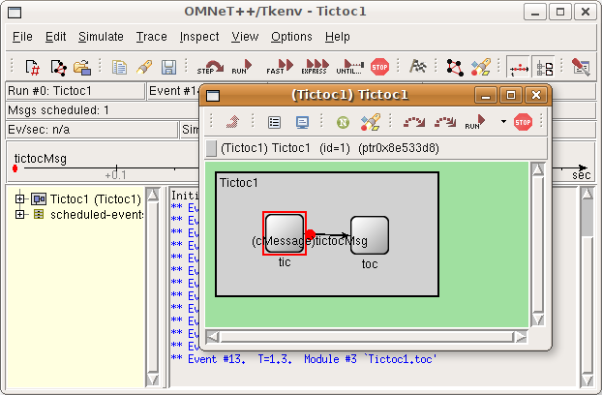
Start the Executable, Run, Play, Exit
./tictoc shall start the simulation environment
Hit Run button to start the actual simulation
Play around, e.g., fast forward, stop, etc.
Hit File->Exit to close the simulation

Slide 18
Enhancing the 2-node TicToc
Step 2: Refining the graphics, and adding debugging output
Step 3: Adding state variables
Step 4: Adding parameters
Step 5: Using inheritance
Step 6: Modeling processing delay
Step 7: Random numbers and parameters
Step 8: Timeout, cancelling timers
Step 9: Retransmitting the same message

Slide 19
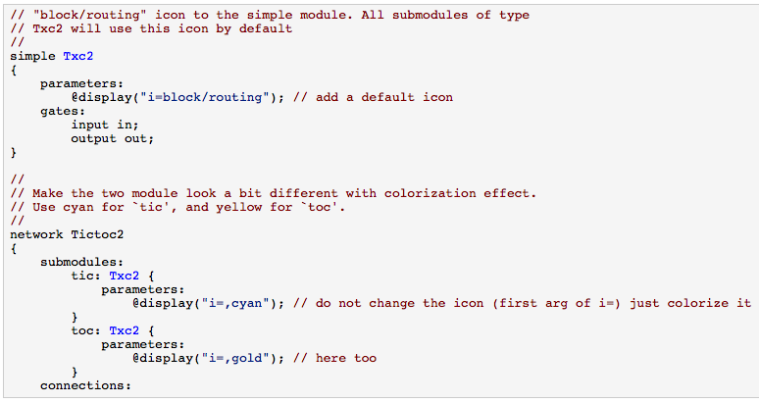
Step 2: Refining the Graphics, and Adding Debugging Output

Slide 20
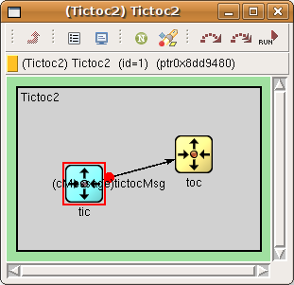
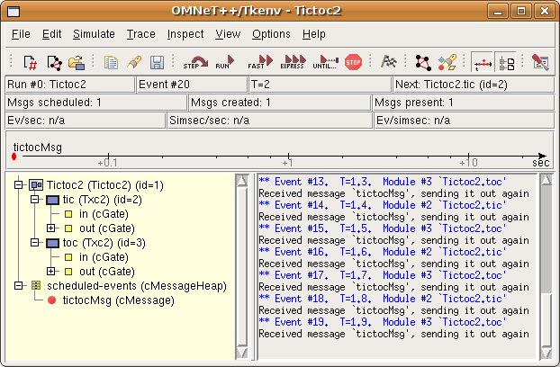
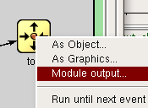
Step 2: Refining the Graphics, and Adding Debugging Output (cont’d)
Debug messages
EV << "Sending initial message\n";
EV << "Received message `" << msg->name() << "', sending it out again\n";
Run the simulation in the OMNeT++ GUI Tkenv.
Open separate output windows for tic and toc by right-clicking on their icons and choosing Module output from the menu – useful for large models.

Slide 21
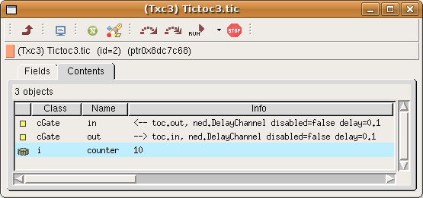
Step 3: Adding State Variables
#include <stdio.h> #include <string.h> #include <omnetpp.h>
class Txc3 : public cSimpleModule {
private:
int counter; // Note the counter here
protected:
virtual void initialize();
virtual void handleMessage(cMessage *msg);
};
Define_Module(Txc3);
void Txc3::initialize() {
counter = 10;
/* The WATCH() statement below will let you examine the variable under Tkenv. After doing a few steps in the simulation, double-click either `tic' or `toc', select the Contents tab in the dialog that pops up, and you'll find "counter" in the list. */
WATCH(counter);
if (strcmp("tic", getName()) == 0) {
EV << "Sending initial message\n“;
cMessage *msg = new cMessage("tictocMsg");
send(msg, "out");
}
}
void Txc3::handleMessage(cMessage *msg) {
counter--; // Increment counter and check value.
if (counter==0) { /* If counter is zero, delete message. If you run the model, you'll find that the simulation will stop at this point with the message "no more events“. */
EV << getName() << "'s counter reached zero, deleting message\n“;
delete msg;
} else { EV << getName() << "'s counter is " << counter << ", sending back message\n"; send(msg, "out"); }
}

Slide 22
Step 4: Adding Parameters
We'll turn the "magic number" 10 into a parameter
Module parameters have to be declared in the NED file: numeric, string, bool, or xml
simple Txc4 {
parameters:
// whether the module should send out a message on initialization
bool sendMsgOnInit = default(false);
int limit = default(2); // another parameter with a default value
@display("i=block/routing");
gates:
Modify the C++ code to read the parameter in initialize(), and assign it to the counter.
counter = par("limit");
Now, we can assign the parameters in the NED file or from omnetpp.ini. Assignments in the NED file take precedence.
network Tictoc4 {
submodules:
tic: Txc4 {
parameters:
sendMsgOnInit = true;
limit = 8; // tic's limit is 8
@display("i=,cyan"); }
toc: Txc4 { // note that we leave toc's limit unbound here
parameters:
sendMsgOnInit = false;
@display("i=,gold"); }
connections:

Slide 23
Step 4: Adding Parameters (cont’d)
… and the other in omnetpp.ini:
Tictoc4.toc.limit = 5
Note that because omnetpp.ini supports wildcards, and parameters assigned from NED files take precedence over the ones in omnetpp.ini, we could have used
Tictoc4.t*c.limit = 5
or
Tictoc4.*.limit = 5
or even
**.limit = 5
with the same effect. (The difference between * and ** is that * will not match a dot and ** will.)

Slide 24
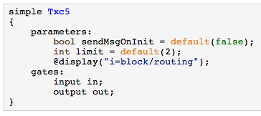
Step 5: Using Inheritance
Take a closer look: tic and toc differs only in their parameter values and their display string => use inheritance

Slide 25
Step 6: Modeling Processing Delay
Hold messages for some time before sending it back ⇨ timing is achieved by the module sending a message to itself (i.e., self-messages)
We "send" the self-messages with the scheduleAt() function
scheduleAt(simTime()+1.0, event);
handleMessage(): differentiate whether a new message has arrived via the input gate or the self-message came back (timer expired)
if (msg==event) or if (msg->isSelfMessage())

Slide 26
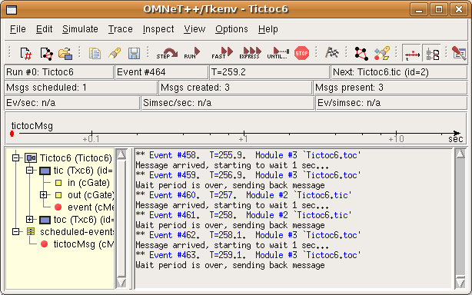
Step 6: Modeling Processing Delay (cont’d)
void Txc6::handleMessage(cMessage *msg) {
// There are several ways of distinguishing messages, for example by message
// kind (an int attribute of cMessage) or by class using dynamic_cast
// (provided you subclass from cMessage). In this code we just check if we
// recognize the pointer, which (if feasible) is the easiest and fastest
// method.
if (msg==event) {
// The self-message arrived, so we can send out tictocMsg and NULL out
// its pointer so that it doesn't confuse us later.
EV << "Wait period is over, sending back message\n";
send(tictocMsg, "out");
tictocMsg = NULL;
} else {
// If the message we received is not our self-message, then it must
// be the tic-toc message arriving from our partner. We remember its
// pointer in the tictocMsg variable, then schedule our self-message
// to come back to us in 1s simulated time.
EV << "Message arrived, starting to wait 1 sec...\n";
tictocMsg = msg;
scheduleAt(simTime()+1.0, event);
}
}

Slide 27
Step 7: Random Numbers and Parameter
Change the delay from 1s to a random value :
// The "delayTime" module parameter can be set to values like
// "exponential(5)" (tictoc7.ned, omnetpp.ini), and then here
// we'll get a different delay every time.
simtime_t delay = par("delayTime");
EV << "Message arrived, starting to wait " << delay << " secs...\n";
tictocMsg = msg;
scheduleAt(simTime()+delay, event);
"Lose" (delete) the packet with a small (hardcoded) probability:
if (uniform(0,1) < 0.1) {
EV << "\"Losing\" message\n";
bubble("message lost");
delete msg;
}
Assign seed and the parameters in omnetpp.ini:
[General]
seed-0-mt=532569 # or any other 32-bit value
Tictoc7.tic.delayTime = exponential(3s)
Tictoc7.toc.delayTime = truncnormal(3s,1s)

Slide 28
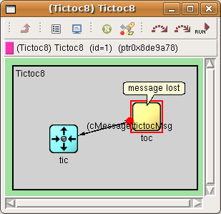
Step 8: Timeout, Cancelling Timers
Transform our model into a stop-and-wait simulation
void Tic8::handleMessage(cMessage *msg) {
if (msg==timeoutEvent) {
// If we receive the timeout event, that means the packet hasn't
// arrived in time and we have to re-send it.
EV << "Timeout expired, resending message and restarting timer\n";
cMessage *msg = new cMessage("tictocMsg");
send(msg, "out");
scheduleAt(simTime()+timeout, timeoutEvent);
} else { // message arrived
// Acknowledgement received -- delete the stored message
// and cancel the timeout event.
EV << "Timer cancelled.\n";
cancelEvent(timeoutEvent);
// Ready to send another one.
cMessage *msg = new cMessage("tictocMsg");
send(msg, "out");
scheduleAt(simTime()+timeout, timeoutEvent);
}
}

Slide 29
Step 9: Retransmitting the Same Message
Keep a copy of the original packet so that we can re-send it without the need to build it again:
Keep the original packet and send only copies of it
Delete the original when toc's acknowledgement arrives
Use message sequence number to verify the model
generateNewMessage() and sendCopyOf()
avoid handleMessage() growing too large

Slide 30
Step 9: Retransmitting the Same Message (cont’d)
cMessage *Tic9::generateNewMessage() {
// Generate a message with a different name every time.
char msgname[20];
sprintf(msgname, "tic-%d", ++seq);
cMessage *msg = new cMessage(msgname);
return msg;
}
void Tic9::sendCopyOf(cMessage *msg) {
// Duplicate message and send the copy.
cMessage *copy = (cMessage *) msg->dup();
send(copy, "out");
}

Slide 31
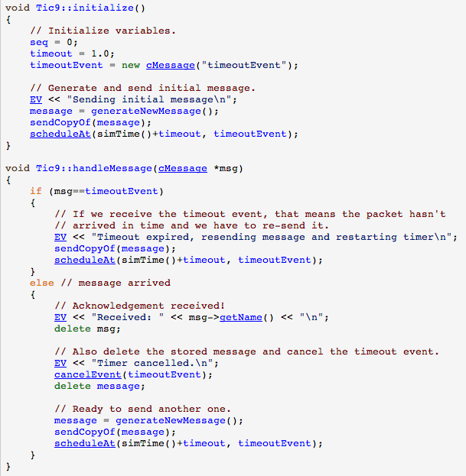

Slide 32
Turning it into a real network
Step 10: More than two nodes
Step 11: Channels and inner type definitions
Step 12: Using two-way connections
Step 13: Defining our message class

Slide 33
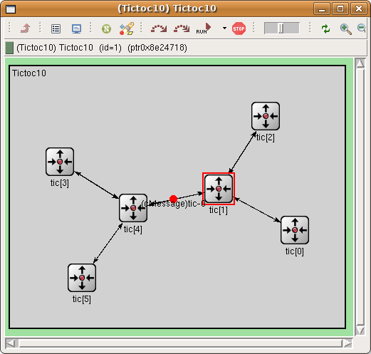
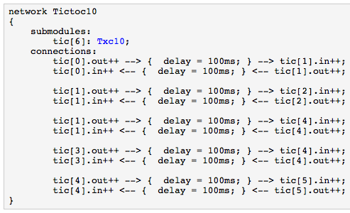
Step 10: More Than Two Nodes

Slide 34
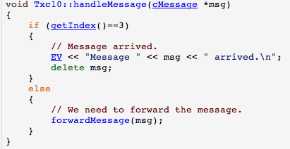
Step 10: More Than Two Nodes (cont’d)
tic[0] will generate the message to be sent around
done in initialize()
getIndex() function which returns the index of the module
forwardMessage(): invoke from handleMessage() whenever a message arrives
void Txc10::forwardMessage(cMessage *msg) {
// In this example, we just pick a random gate to send it on.
// We draw a random number between 0 and the size of gate `out[]'.
int n = gateSize("out”);
int k = intuniform(0,n-1);
EV << "Forwarding message " << msg << " on port out[" << k << "]\n";
send(msg, "out", k);
}
When the message arrives at tic[3], its handleMessage() will delete the message

Slide 35
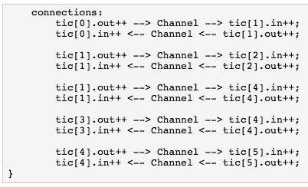
Step 11: Channels and Inner Type Definitions
Network definition is getting quite complex and long, e.g., connections section
Note: built-in DelayChannel (import ned.DelayChannel)

Slide 36
Step 12: Using Two-Way Connections
Each node pair is connected with two connections => OMNeT++ 4 supports 2-way connections
The new connections section would look like this:

Slide 37
Step 12: Using Two-Way Connections (cont’d)
We have modified the gate names => some modifications to the C++ code.
Note: The special $i and $o suffix after the gate name allows us to use the connection's two direction separately.

Slide 38
Step 13: Defining our Message Class
Destination address is no longer hardcoded tic[3] – add destination address to message
Subclass cMessage: tictoc13.msg
message TicTocMsg13 {
fields:
int source;
int destination;
int hopCount = 0;
}
opp_msgc is invoked and it generates tictoc13_m.h and tictoc13_m.cc
Include tictoc13_m.h into our C++ code, and we can use TicTocMsg13 as any other class
#include "tictoc13_m.h"
TicTocMsg13 *msg = new TicTocMsg13(msgname);
msg->setSource(src);
msg->setDestination(dest);
return msg;

Slide 39
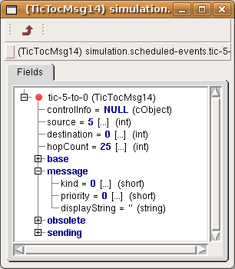
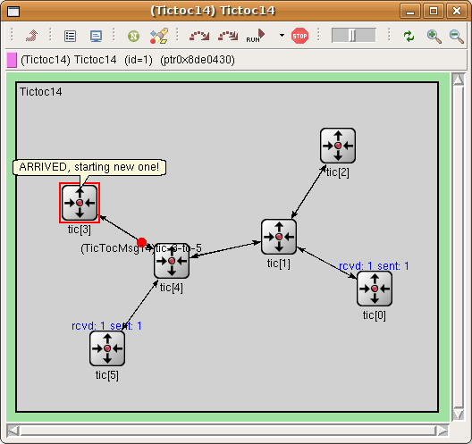
Step 13: Defining our Message Class (cont’d)
Use dynamic cast instead of plain C-style cast ((TicTocMsg13 *)msg) which is not safe
void Txc13::handleMessage(cMessage *msg) {
TicTocMsg13 *ttmsg = check_and_cast<TicTocMsg13 *>(msg);
if (ttmsg->getDestination()==getIndex()) {
// Message arrived.
EV << "Message " << ttmsg << " arrived after " << ttmsg->getHopCount() << " hops.\n";
bubble("ARRIVED, starting new one!");
delete ttmsg;
// Generate another one.
EV << "Generating another message: ";
TicTocMsg13 *newmsg = generateMessage();
EV << newmsg << endl;
forwardMessage(newmsg);
} else {
// We need to forward the message.
forwardMessage(ttmsg);
}
}

Slide 40
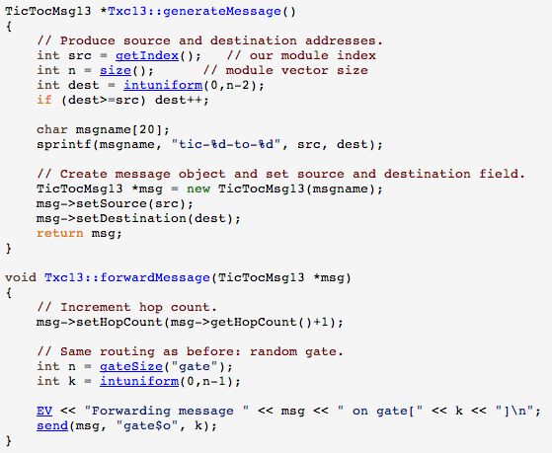
Step 13: Defining our Message Class (cont’d)

Slide 41
Adding statistics collection
Step 14: Displaying the number of packets sent/received
Step 15: Adding statistics collection

Slide 42
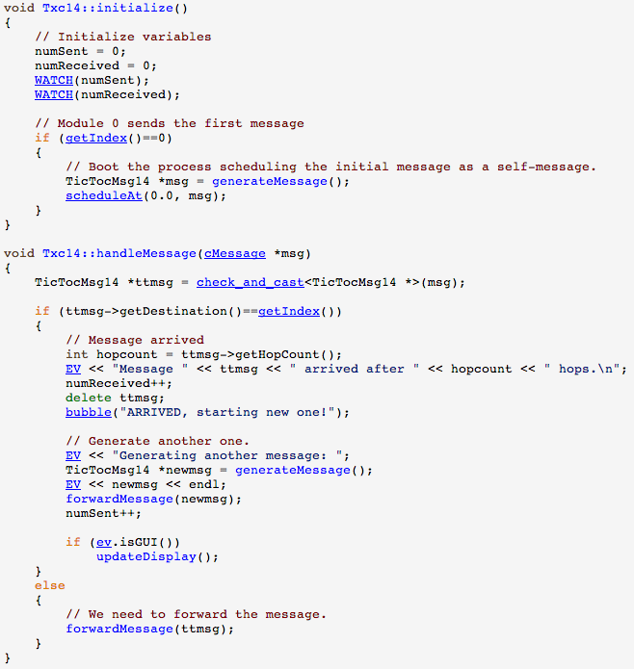
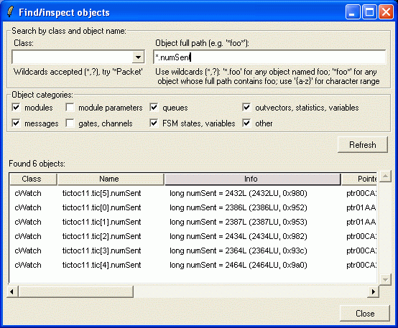
Step 14: Displaying the Number of Packets Sent/Received
Add two counters to the module class: numSent and numReceived
Set to zero and WATCH'ed in the initialize() method
Use the Find/inspect objects dialog (Inspect menu; it is also on the toolbar)

Slide 43
Step 14: Displaying the Number of Packets Sent/Received (cont’d)
This info appears above the module icons using the t= display string tag
if (ev.isGUI())
updateDisplay();
void Txc11::updateDisplay(){
char buf[40];
sprintf(buf, "rcvd: %ld sent: %ld", numReceived, numSent);
getDisplayString().setTagArg("t",0,buf);
}

Slide 44
Step 15: Adding statistics collection
OMNeT++ simulation kernel: omnetpp.ini
Example: average hopCount a message has to travel before reaching its destination
Record in the hop count of every message upon arrival into an output vector (a sequence of (time,value) pairs, sort of a time series)
Calculate mean, standard deviation, minimum, maximum values per node, and write them into a file at the end of the simulation
Use off-line tools to analyse the output files

Slide 45
Step 15: Adding statistics collection (cont’d)
Output vector object (which will record the data into omnetpp.vec) and a histogram object (which also calculates mean, etc)
class Txc15 : public cSimpleModule {
private:
long numSent;
long numReceived;
cLongHistogram hopCountStats;
cOutVector hopCountVector;
Upon message arrival, update statistics within handleMessage()
hopCountVector.record(hopcount);
hopCountStats.collect(hopcount);
hopCountVector.record() call writes the data into Tictoc15-0.vec (will be deleted each time the simulation is restarted)

Slide 46
Step 15: Adding statistics collection (cont’d)
Scalar data (histogram object) have to be recorded manually, in the finish() function
void Txc15::finish() {
// This function is called by OMNeT++ at the end of the simulation.
EV << "Sent: " << numSent << endl;
EV << "Received: " << numReceived << endl;
EV << "Hop count, min: " << hopCountStats.getMin() << endl;
EV << "Hop count, max: " << hopCountStats.getMax() << endl;
EV << "Hop count, mean: " << hopCountStats.getMean() << endl;
EV << "Hop count, stddev: " << hopCountStats.getStddev() << endl;
recordScalar("#sent", numSent);
recordScalar("#received", numReceived);
hopCountStats.recordAs("hop count");
}
recordScalar() calls in the code below write into the Tictoc15-0.sca file
Tictoc15-0.sca not deleted between simulation runs; new data are just appended – allows to jointly analyze data from several simulation runs

Slide 47
Step 15: Adding statistics collection (cont’d)
You can also view the data during simulation. In the module inspector's Contents page you'll find the hopCountStats and hopCountVector objects, and you can open their inspectors (double-click). They will be initially empty -- run the simulation in Fast (or even Express) mode to get enough data to be displayed. After a while you'll get something like this:

Slide 48
Step 16: Statistic collection without modifying your model
OMNeT++ 4.1 provides an additional mechanism to record values and events
Any model can emit 'signals' that can carry a value or an object
The model writer just have to decide what signals to emit, what data to attach to them and when to emit them
The end user can attach 'listeners' to these signals that can process or record these data items
This way the model code does not have to contain any code that is specific to the statistics collection
The end user can freely add additional statistics without even looking into the C++ code
We can safely remove all statistic related variables from our module
No need for the cOutVector and cLongHistogram classes either
Need only a single signal that carries the hopCount of the message at the time of message arrival at the destination

Slide 49
Step 16: Statistic collection without modifying your model (cont’d)
Define our signal: arrivalSignal as identifier
We must register all signals before using them
Emit our signal, when the message has arrived to the destination node. finish() method can be deleted!

Slide 50
Step 16: Statistic collection without modifying your model (cont’d)
Declare signals in the NED file
Configuration via ini file

Slide 51
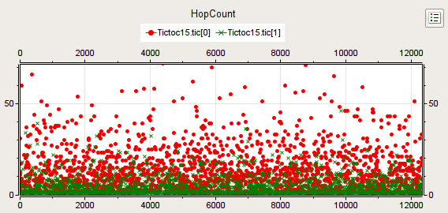
Visualizing the results with the OMNeT++ IDE
OMNet++ IDE can be used to analyze the results.
Our last model records the hopCount of a message each time the message reaches its destination.
The following plot shows these vectors for nodes 0 and 1.

Slide 52
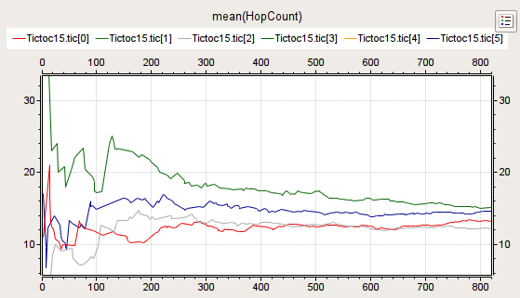
Visualizing the results with the OMNeT++ IDE (cont’d)
If we apply a mean operation we can see how the hopCount in the different nodes converge to an average:

Slide 53
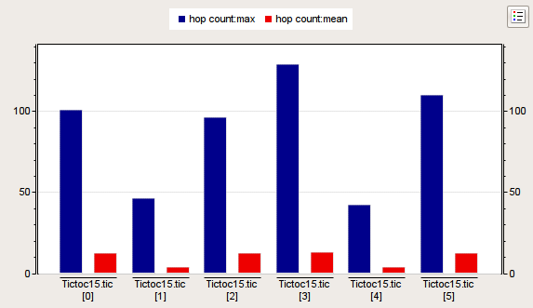
Visualizing the results with the OMNeT++ IDE (cont’d)
Mean and the maximum of the hopCount of the messages for each destination node
based on the scalar data recorded at the end of the simulation.

Slide 54
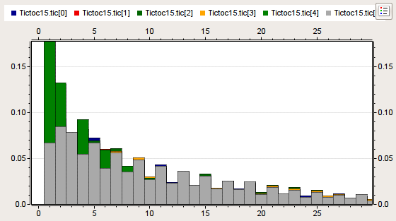
Visualizing the results with the OMNeT++ IDE (cont’d)
Histogram of hopCount's distribution.

Slide 55
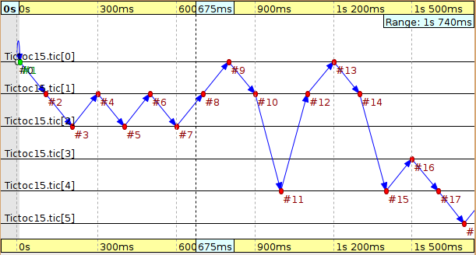
Visualizing the results with the OMNeT++ IDE (cont’d)
OMNeT++ simulation kernel can record the message exchanges during the simulation => event log file => analyzed with Sequence Chart tool
E.g., message is routed between the different nodes in the network

Slide 56
Conclusions
OMNeT++: discrete event simulation system
OMNeT++ is a
public-source,
component-based,
modular and open-architecture simulation environment
with strong GUI support and
an embeddable simulation kernel
OMNeT++ 4.5 IDE (Eclipse)
http://www.omnetpp.org/doc/omnetpp/UserGuide.pdf
http://www.omnetpp.org/documentation

Slide 57
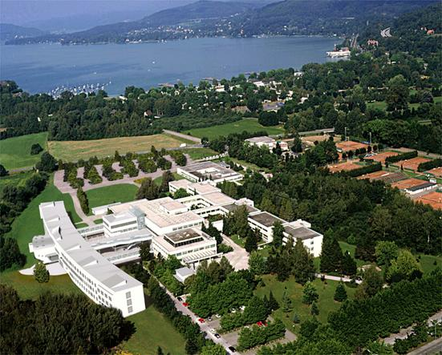
Thank you for your attention
... questions, comments, etc. are welcome …
Priv.-Doz. Dipl.-Ing. Dr. Christian Timmerer
Alpen-Adria-Universität Klagenfurt, Institute of Information Technology (ITEC)
Universitätsstrasse 65-67, A-9020 Klagenfurt, AUSTRIA
christian.timmerer@itec.uni-klu.ac.at
http://blog.timmerer.com/
Tel: +43/463/2700 3621 Fax: +43/463/2700 3699
© Copyright: Christian Timmerer

